Slide 1
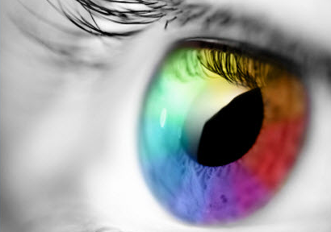
MassMutual DSDP 2021: Perception & Color
June 29, 2021
R. Jordan Crouser
Associate Professor of Computer Science
Smith College

Slide 2


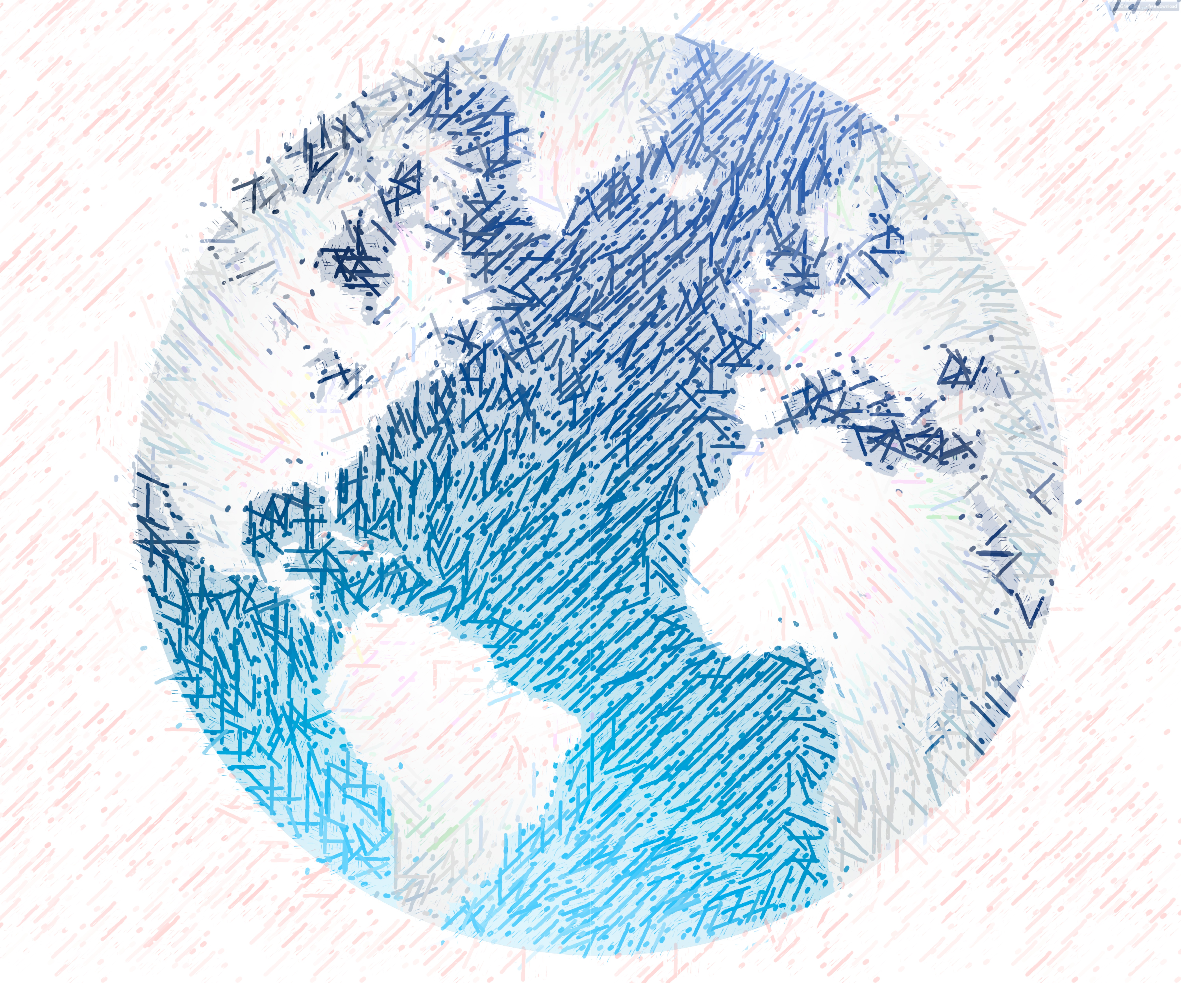

Recall: mental models
Question:
How do we manage
to navigate the world?

Slide 3
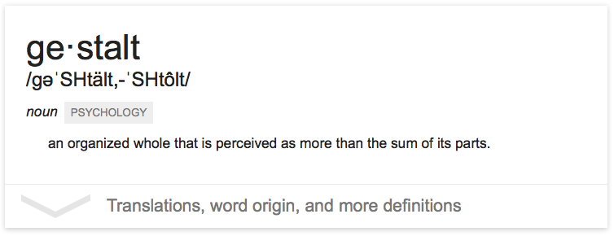
The “gestalt effect”
Our brain’s ability to generate whole forms, instead of just collections of unrelated elements

Slide 4
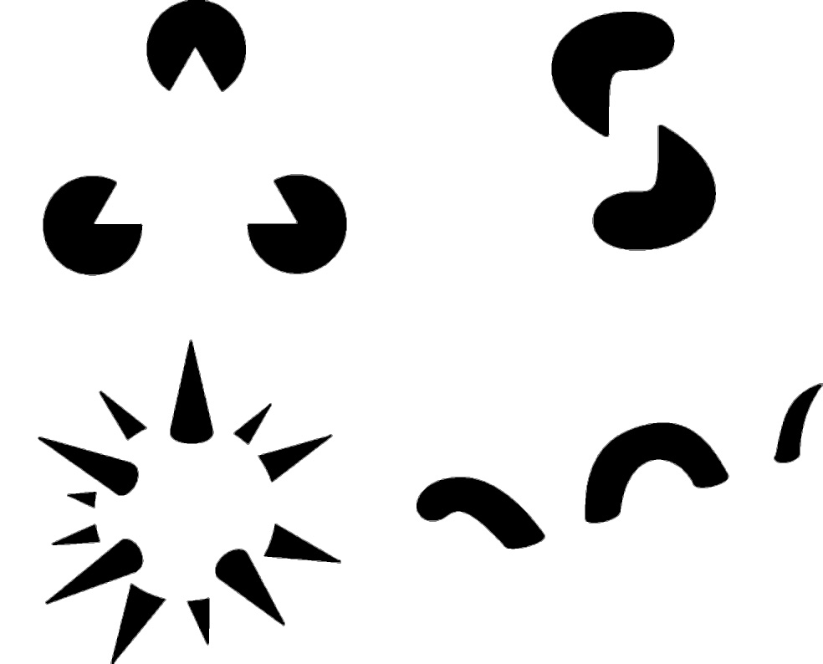
1. Reification
Demonstration of reification in perception from Lehar S. (2003)
The World In Your Head, Lawrence Erlbaum, Mahwah, NJ. p. 52, Fig. 3.3

Slide 5
2. Emergence
Life Magazine: 58;7 1965-02-19, p 120. Photographer: Ronald C James

Slide 6
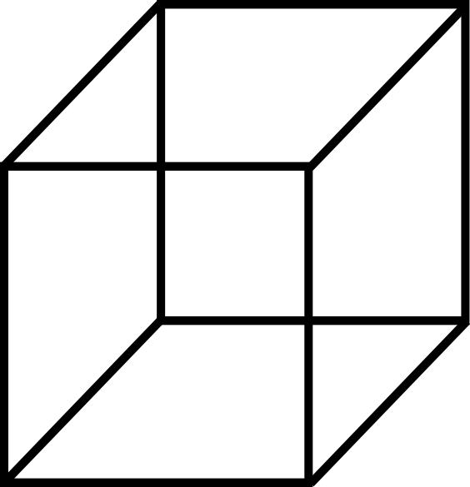
3. Multistability

Slide 7
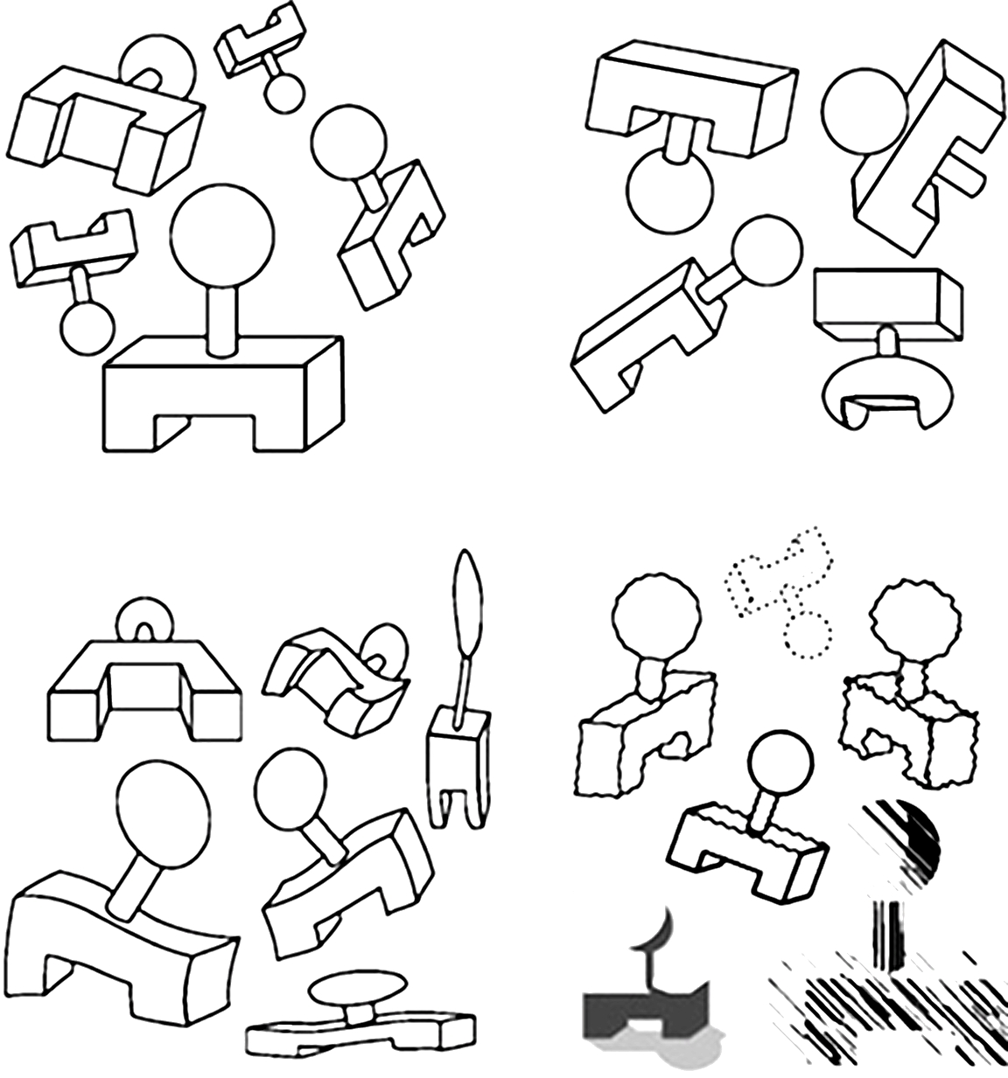
4. Invariance
Demonstration of invariance in perception from Lehar S. (2003)
The World In Your Head, Lawrence Erlbaum, Mahwah, NJ. p. 53, Fig. 3.5

Slide 8

Hacking the brain
Question: what makes all this mental model stuff useful to us (designers and readers of data)?
Answer: in order to understand how people interpret and make sense of data, we need to know what cues they’re picking up on – and how to situate those cues within a larger framework

Slide 9
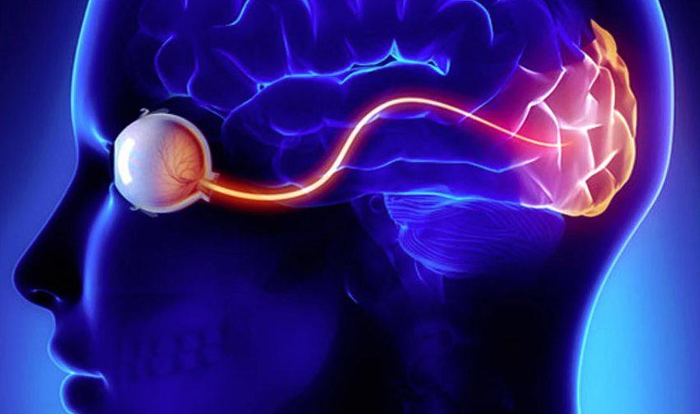
Visual perception (def.)
the (sometimes imperfect)
process by which we
detect and interpret
visual signals

Slide 10
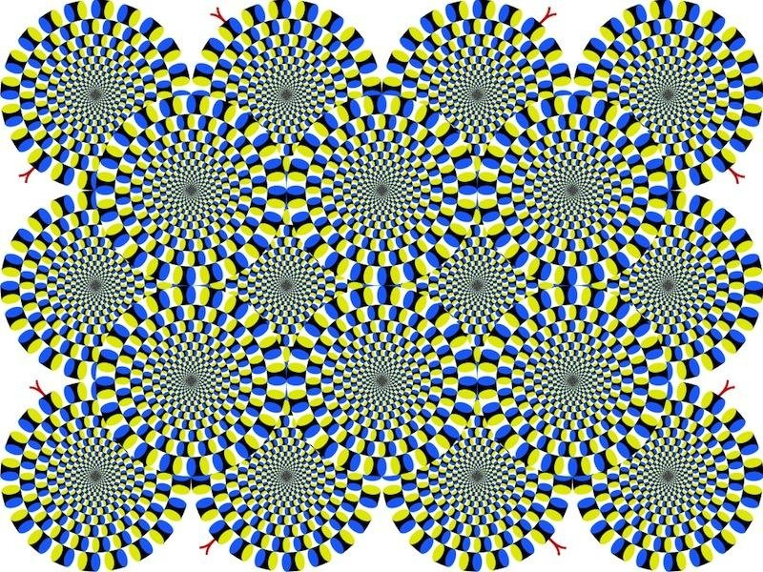

Slide 12
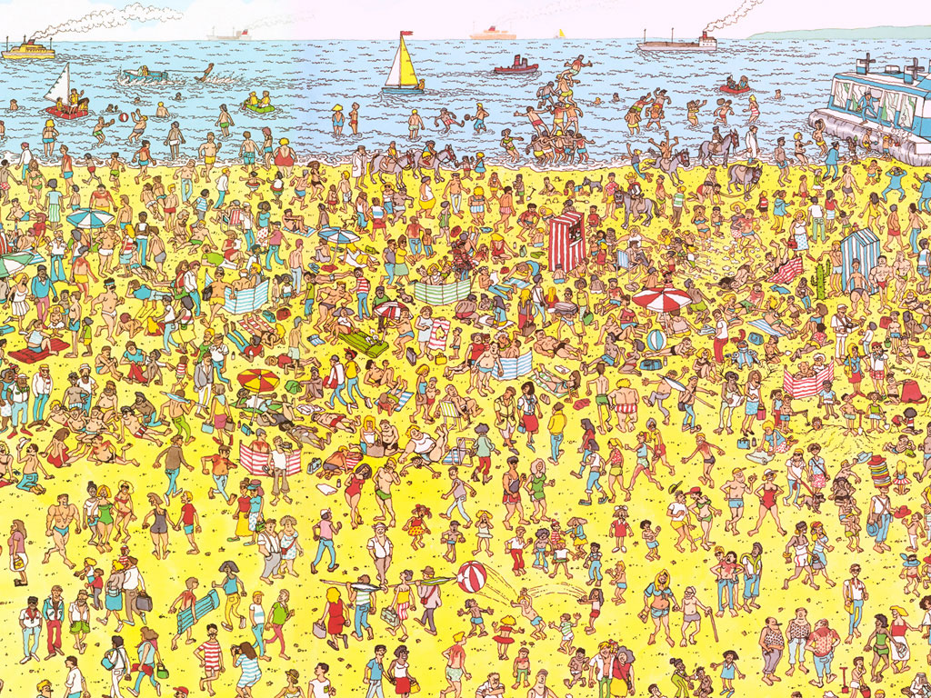
Some things are processed slowly

Slide 13
Others are incredibly fast

Slide 14
Fast = “pre-attentive processing”
Things that happen in <200ms of visual stimulation
Performed in parallel across the entire visual field
Example:

Slide 15
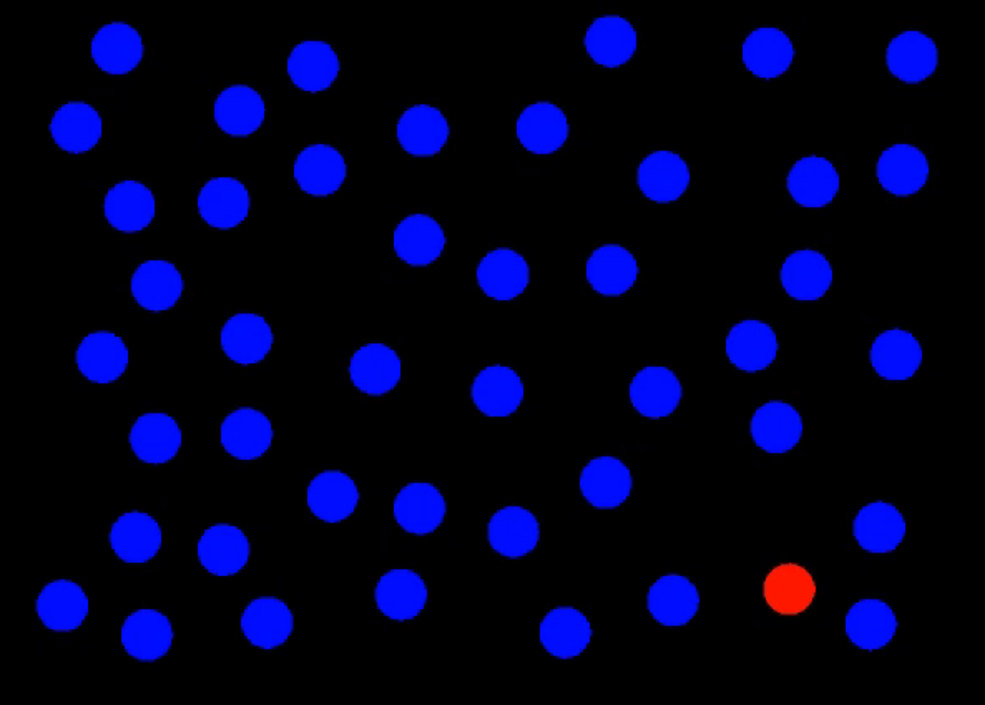
Perception: Preattentive Processing

Slide 16
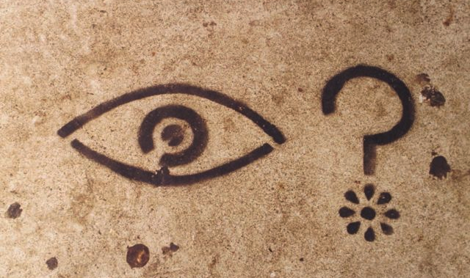
What did you see?
Notes:
Clocked my spacebar double-tap ability at about 80ms on average.
Without knowing what you were going to see, you likely attuned to the red dot in the field of blue dots.
This is the power of preattentive processing.

Slide 17
Pre-attentive processing facilitates:
Target detection (presence or absence)
Boundary detection / grouping
Region tracking
Counting and estimation

Slide 18
Attentive counting
1281768756138976546984506985604982826762
9809858458224509856458945098450980943585
9091030209905959595772564675050678904567
8845789809821677654876364908560912949686
How many threes are there?

Slide 19
Pre-attentive counting
1281768756138976546984506985604982826762
9809858458224509856458945098450980943585
9091030209905959595772564675050678904567
8845789809821677654876364908560912949686
How many threes are there?

Slide 20
Pre-attentive processing: color (hue)

Slide 21
Pre-attentive processing: shape (curvature)

Slide 22
Pre-attentive processing: shape + color?

Slide 23
Discussion: what’s going on here?
Answer: this is called “conjunction”
If you search for red things, you get a bunch of red circles (as well as the red triangle).
Similarly, if you search for search for triangles, you get a bunch of blue triangles (as well as the red triangle).
Either way, you have to search through them all one by one!

Slide 24
Pre-attentive processing for visualization
Whatever draws our eyes draws our attention
This can be useful
It can also be problematic:

Slide 25

Ex. flicker can cause change blindness

Slide 26


Can you see it now?
Notes:
Not only is this comparison easier, but if we now go back to the original flickering image, you won’t have the same problem – you can’t “unsee” the answer.

Slide 27

Sometimes gestalt & pre-attention compete

Slide 28
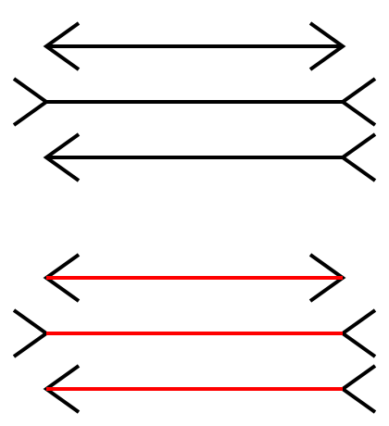
Sometimes gestalt & pre-attention compete

Slide 29
Magnitude estimation
Question: How much bigger is the lower bar?
Answer: 2x

Slide 30
Magnitude estimation
Question: How much bigger is the right square?
Answer: 4x

Slide 31
Magnitude estimation
Question: How much bigger is the left cube?
Answer: 27x

Slide 32
“Apparent” magnitude
Length
estimate
correctly
Area
under-
estimate
Actual
perfect correspondence
Volume
way under-
estimate
Perceived
http://makingmaps.net/2007/08/28/perceptual-scaling-of-map-symbols/

Slide 33
Mapping to visual dimensions
 | Perceived as similar | Perceived as different, forming families | Perceived as ordered | Perceived as proportional
SIZE | ?
VALUE | ?
COLOR |  |  | ?
SHAPE
ORIENTATION

Slide 34
Back in 10 minutes

Slide 35

Color 101

Slide 36
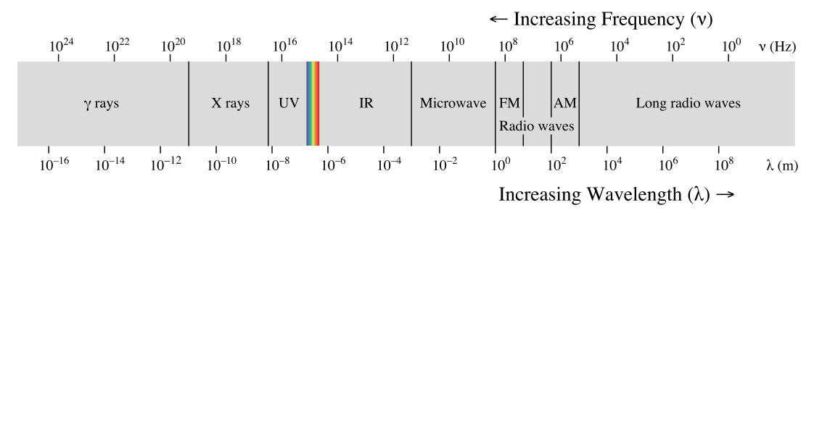
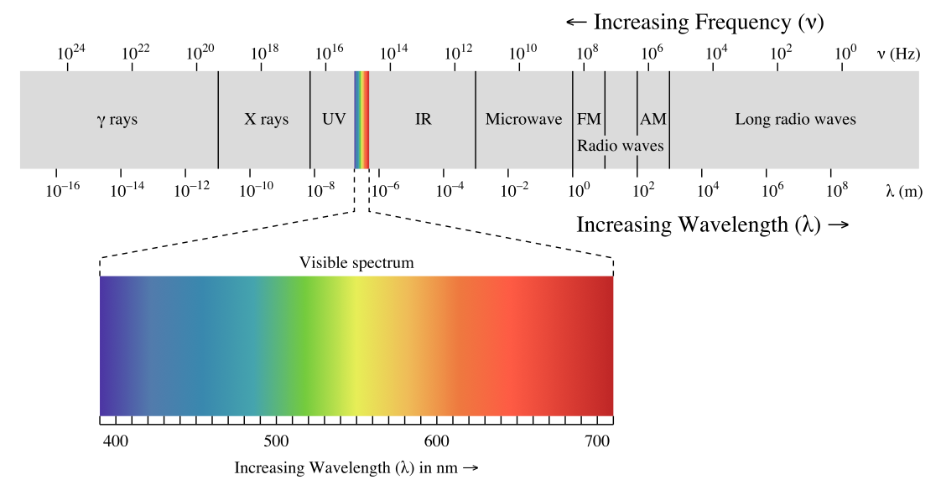

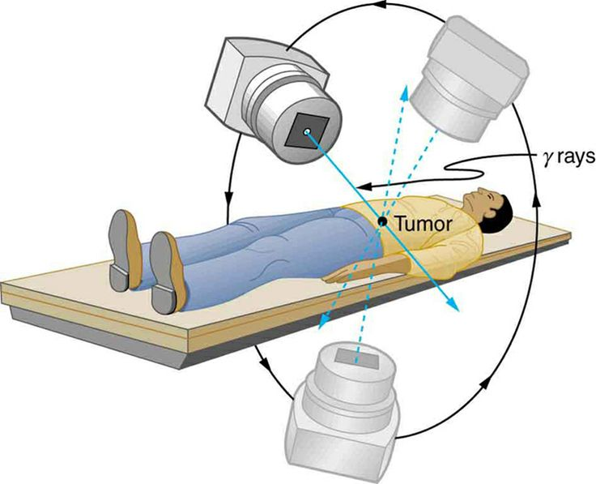
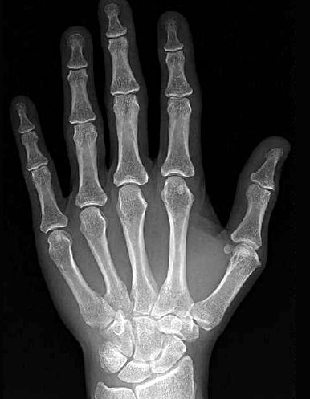

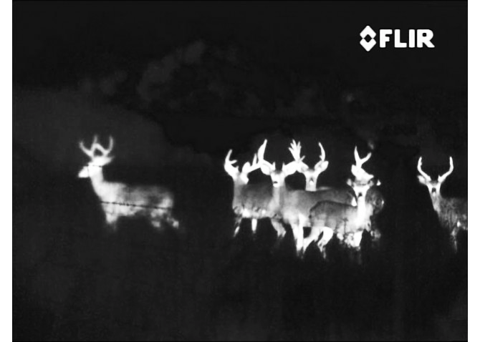
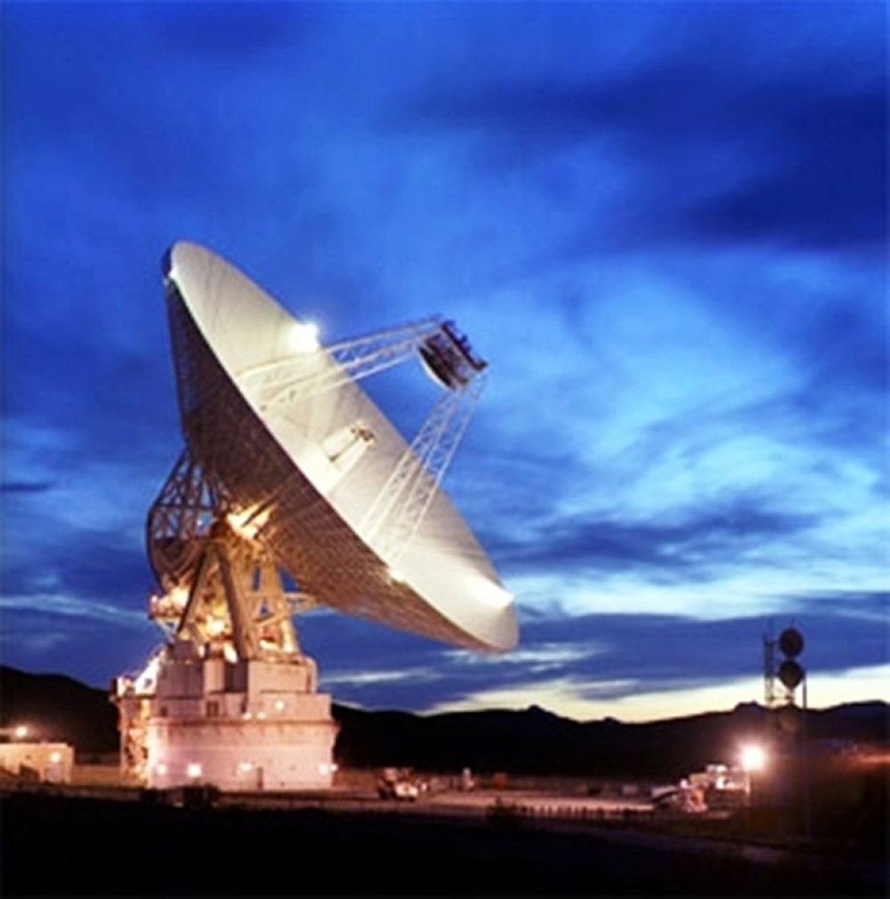

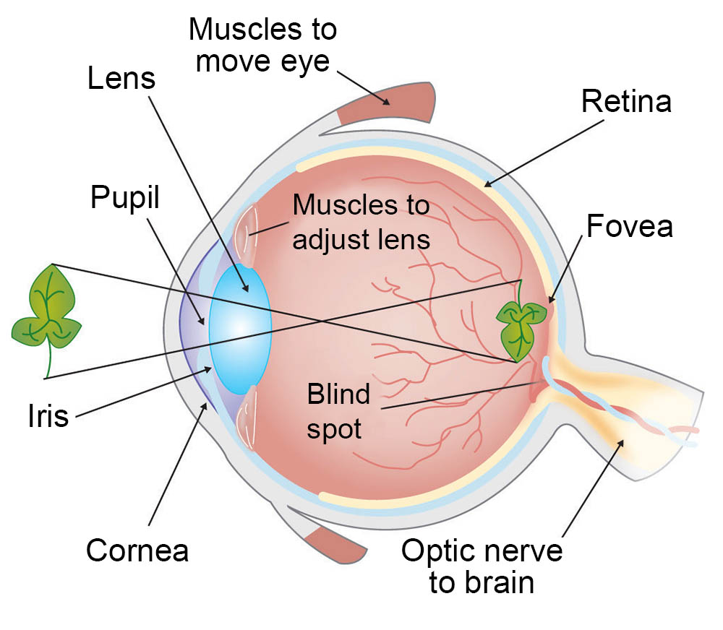
Kinds of light
Eye diagram courtesy ASU

Slide 37

How we see color

Slide 38
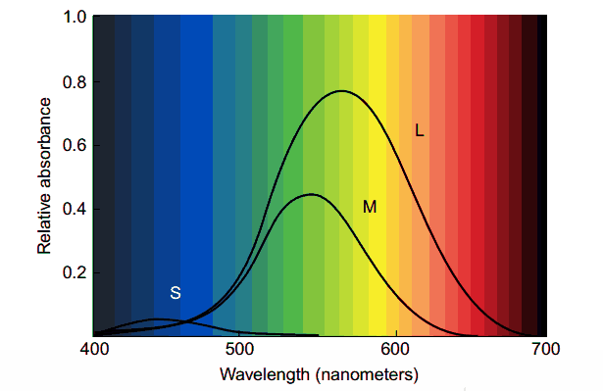
3 kinds of color sensors

Slide 39
Discussion: what do you notice?

Slide 40
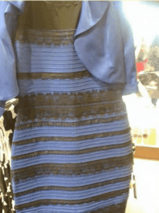

Color phenomena

Slide 41
Caveat 1: color is perceived in context
Which small square is darker green?

Slide 42


Caveat 2: difference is relative

Slide 43

Caveat 2a: so are brightness and contrast

Slide 44
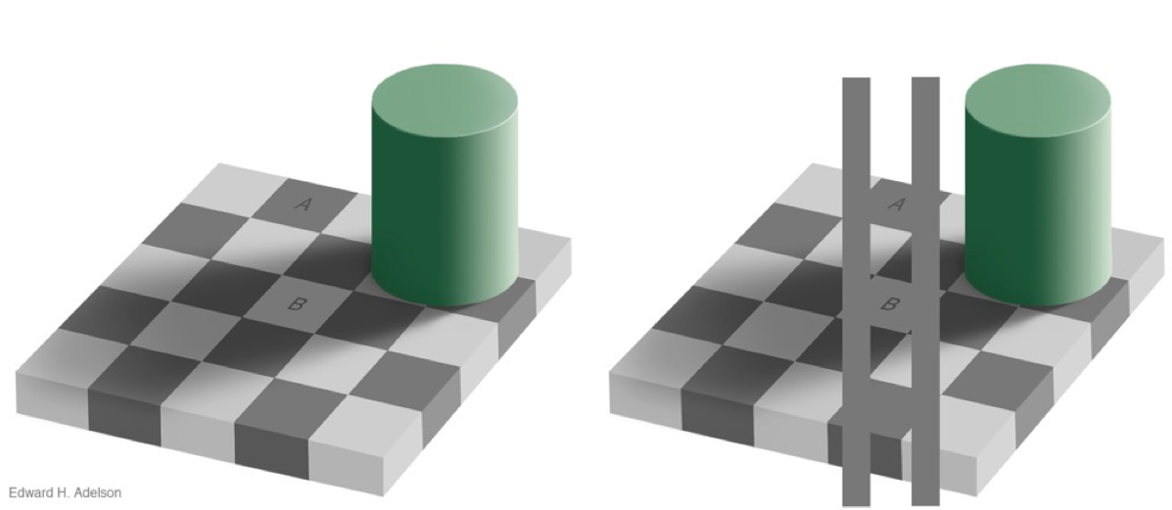
Caveat 3: mental models > perception

Slide 45
Takeaways: Perception
Visualization is about more than just aesthetics
There are compelling cognitive reasons why some visualization techniques are helpful and others aren’t
The choices we make about visual mappings can have a significant effect on performance

Slide 46
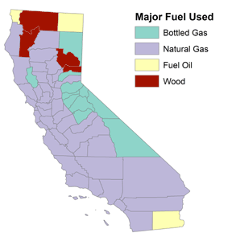
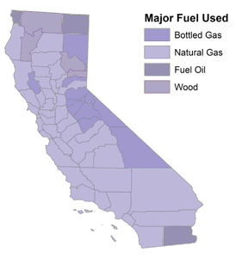
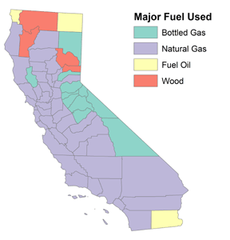
Categorical color schemes
Different color = different category
Protip #1: choose colors that are perceptually distant
Protip #2: choose colors that are roughly the same saturation and value

Slide 47
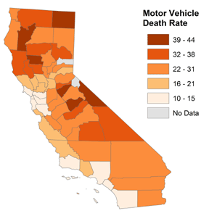
Sequential color schemes: one hue
Saturation indicates difference in the amount of the phenomenon
Protip #1: no more than 5-6 levels
Protip #2: people interpret darker = more

Slide 48
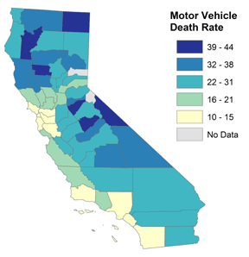
Sequential color schemes: multi-hue
Hue indicates difference in the amount of the phenomenon
Protip #1: no more than 2 anchor colors
Protip #2: people interpret high saturation = more

Slide 49
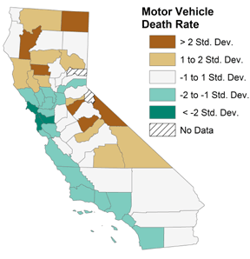
Diverging color schemes
Two colors used to indicate extremes of a range
Protip #1: neutral color in the middle
Protip #2: differentiate between “average” and “no data’

Slide 50

Lab 3: colorbrewer and ggthemes

